Slide 1
Working with the public to improve digital forms: A GSA case study
Digital.gov event
March 2, 2023
Stephanie Permut
stephanie.permut@gsa.gov
Blair Read blair.read@gsa.gov
Mary Clair Turner maryclair.turner@gsa.gov

Slide 2
21st Century Integrated Digitial Experience Act
SEC. 4. DIGITIZATION OF GOVERNMENT SERVICES AND FORMS.
Non-Digital Services.–Not later than 180 days after the date of enactment of this Act, the Director shall issue guidance to the head of each executive agency that establishes a process for the executive agency to–
identify public non-digital, paper-based, or in-person Government services; and
include in the budget request of the executive agency–
(A.) a list of non-digital services with the greatest impact that could be made available to the public through an online, mobile-friendly, digital service option in a manner that decreases cost, increases digital conversion rates, and improves customer experience; and
(B.) an estimation of the cost and schedule associated with carrying out the modernization described in subparagraph (A).
Visit the digital.gov resource page for more information:
https://digital.gov/resources/21st-century-integrated-digital-experience-act/

Slide 3
Overview
Office of Evaluation Sciences (OES) overview
How to evaluate the impact of form changes
Case study: Proof of concept evaluation with a model form
Case study: Evaluation of a form change in the field
Takeaways and next steps in form evaluation

Slide 4
Office of Evaluation Sciences
4

Slide 5

Who is OES?
Since 2015, OES has recruited over 150 interdisciplinary experts into federal government, representing a mix of Federal Employees, Fellows, and Academic Affiliates
Federal employees
Fellows and academic affiliates
Notes:
With the formal launch of the White House’s Social and Behavioral Science Team (SBST) and General Services Administration Office of Evaluation Sciences in 2015. Governments at all levels have created teams dedicated to using behavioral science to improve government services. As of last count, there are more than 200 such units globally (OECD, 2017). In 2015, Executive Order 13707 Using Behavioral Science Insights To Better Serve the American People was signed by President Barack Obama. These teams often bring diverse academic and applied expertise to more deeply understand behavioral bottlenecks and offer recommendations drawn from peer-reviewed evidence in the social and behavioral sciences.

Slide 6



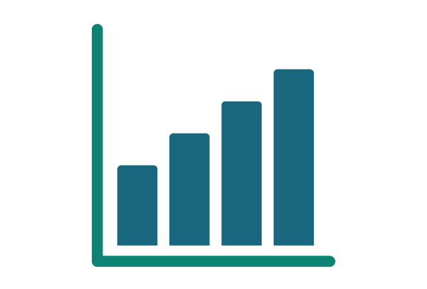


Building and using evidence to better serve the public
OES team members work alongside agency collaborators to design and evaluate program changes.
Applying Behavioral Science
Quickly and Confidently Learning What Works
Partner with Federal Agencies to target priority outcomes
Translate behavioral insights into concrete recommendations
Embed evaluations
Analyze results using existing administrative data
Ensure our work meets evaluation best practice
Measure impact and build evidence to continuously improve

Slide 7
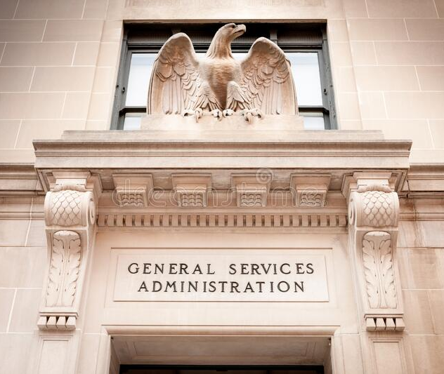
Based at GSA
The United States General Services Administration (GSA) exists to support the government in becoming more effective and efficient

Slide 8
Randomized Evaluation Design
8

Slide 9


So you want to measure the impact of a form change…
To understand the impact of a form change, you need to know what would have happened if you had done nothing
1. By comparing the world before to the world after the intervention.
Before form change
After form change
but…
Quarterly changes
Form change
COVID-19
Other, external events
Reported same sales
Reported more sales
Notes:
Suppose you want to measure how a program change affects payment integrity

Slide 10

So you want to measure the impact of a form change…
To understand the impact of a form change, you need to know what would have happened if you had done nothing
2. By comparing cases (individuals, groups, …) exposed to the intervention with other cases that are similar
Would you like to try a new reporting form we’re testing?
Users seeing old form
Stays the same
Different users seeing new form
Increase in sales reported!
Sure!! I’m already a conscientious federal vendor

Slide 11
Randomized Evaluations 1
Study sample can be drawn from the total population of federal vendors…

Slide 12
Randomized Evaluations 2
Study sample can be drawn from the total population of federal vendors…
or the subset of federal vendors who improperly reported sales in the past

Slide 13
Randomized Evaluations 3

Slide 14

Randomized Evaluations 4
Graphic from Haynes, L., Service, O., Goldacre, B., & Torgerson, D. (2012). Test, Learn, Adapt: Developing Public Policy with Randomised Controlled Trials. London: Cabinet Office Behavioural Insights Team.

Slide 15
Randomized Evaluations 5
Intervention
Control
Reported same sales
Reported more sales
Graphic from Haynes, L., Service, O., Goldacre, B., & Torgerson, D. (2012). Test, Learn, Adapt: Developing Public Policy with Randomised Controlled Trials. London: Cabinet Office Behavioural Insights Team.

Slide 16
Randomized Evaluations
Effect on outcome is caused by intervention
Measure the size and direction of effect, as well as potential unintended consequences
Build credible estimates that can be used to measure return on investment (ROI) of intervention
Without conducting an audit can proxy for payment integrity outcomes

Slide 17
Evaluation of a Model Form
17
Notes:
Blair

Slide 18
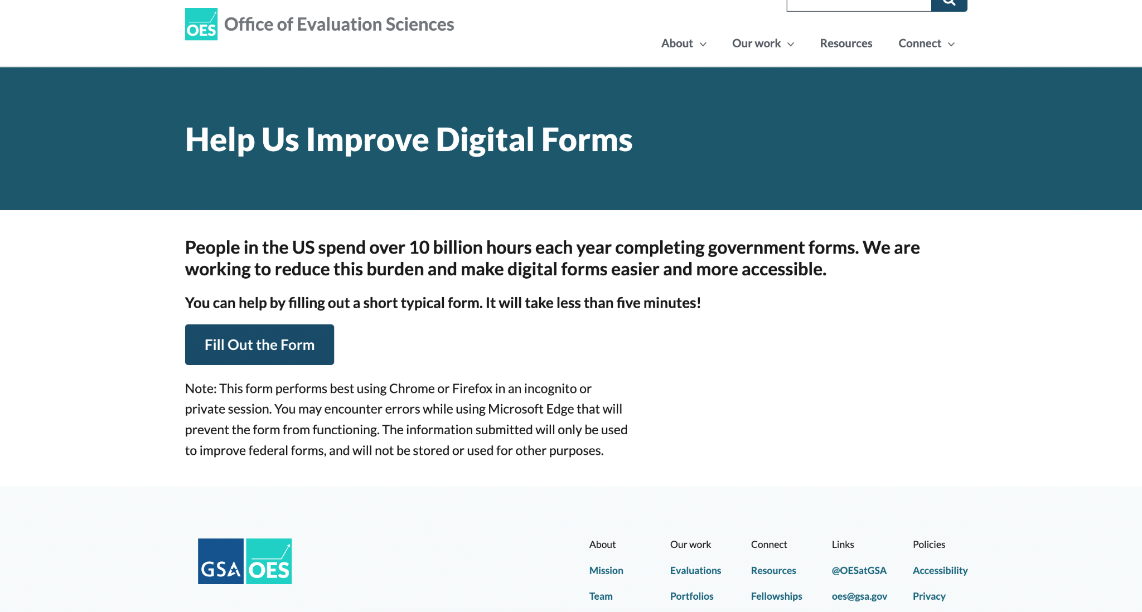
Model Form
Notes:
By model form, we mean project we did before that would be hosted on the OES website

Slide 19
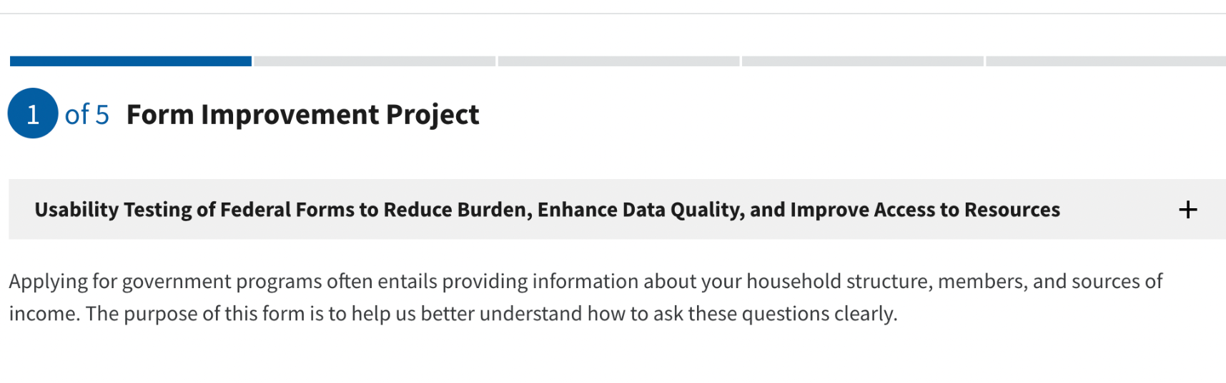
Incorporating Evaluation into Digital Forms
What was the challenge?
The American public spends ~ 11.5 billion hours per year filling out complex federal government forms.
OES evaluated two versions of a brief digital form with questions typical of federal forms.
What was the program change?
One version included the form instructions on the first page, while the other version embedded the form instructions within each page of the form.

Slide 20
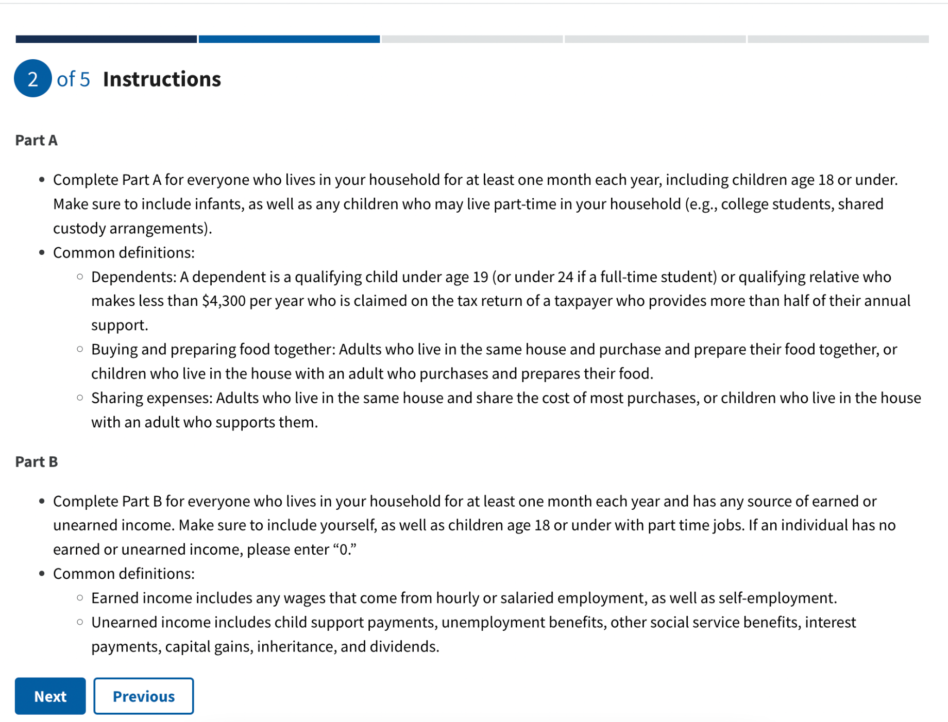
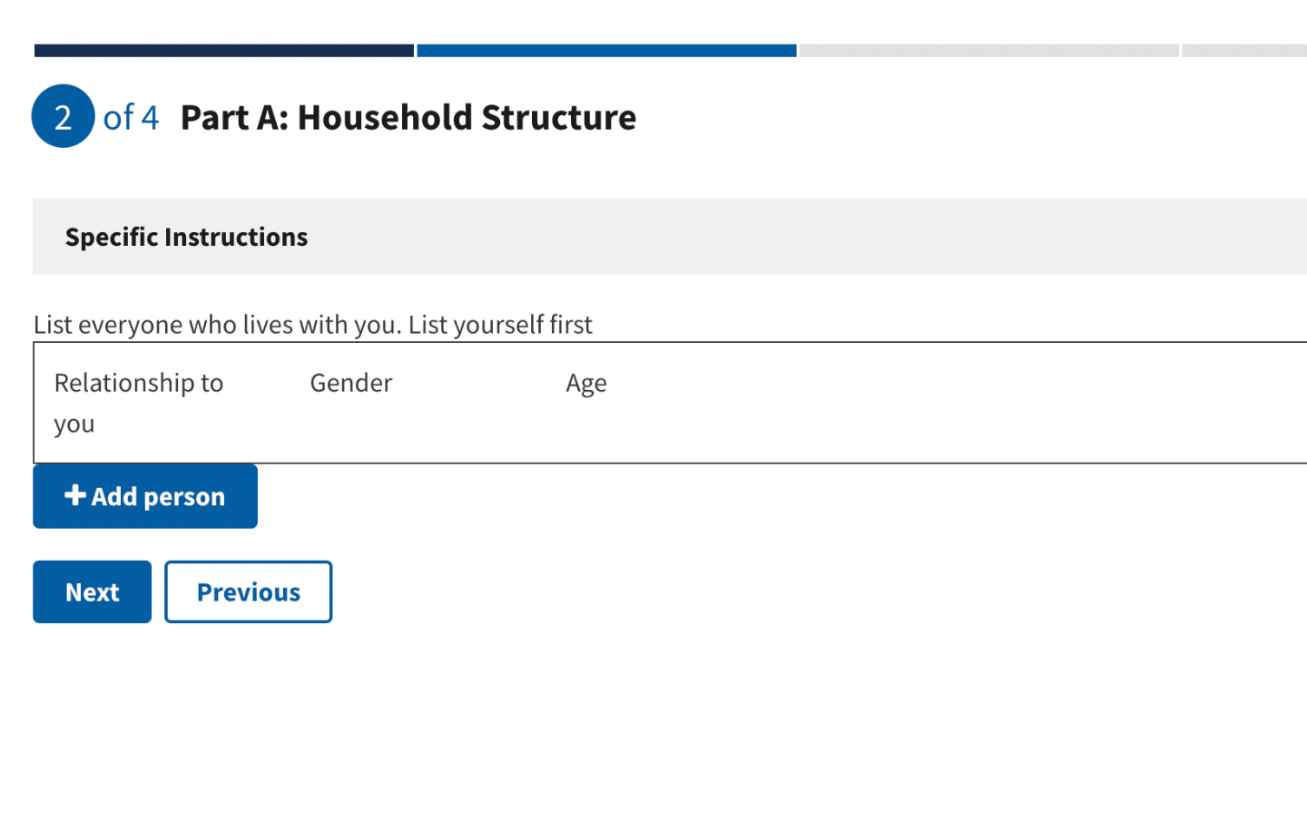
Form Location and Design
Form A: Instructions at Front
Form B: Embedded Instructions
Notes:
Other Collaboration

Slide 21
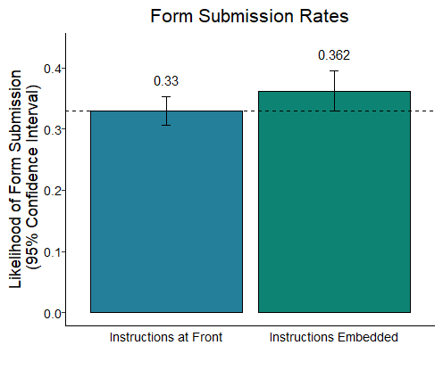
Incorporating Evaluation into Digital Forms 1
What was the outcome?
Initial evidence that form completion is affected by instruction placement.
Individuals randomly assigned to the form with embedded instructions were 3.2 percentage points (36.2% versus 33.0%) more likely to submit (p=0.054, 95% CI [-0.001, 0.065]) than individual assigned to the form with instructions at the front.

Slide 22



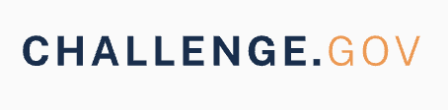

Incorporating Evaluation into Digital Forms 2
How did the evaluation work?
To generate a sample of users, OES conducted outreach among the general public and federal employees. Through this outreach, 3,203 individuals were randomly assigned to the two versions of the form between July 19 and August 19, 2022.
How did the outreach work?
Outreach collaboration between OES, GSA, USAGov, Challenge.gov, and Digital.gov CX COP
Multi-platform approach including Social Media, Newsletters, Listservs, and Websites

Slide 23
THANK YOU!
CX COP

Slide 24
Process
Read email
Instructions at Front
Click on link to fill out form
Click on link to form
Visit Social Media
Instructions Embedded
Visit Challenge.gov
Visit OES.gov

Slide 25

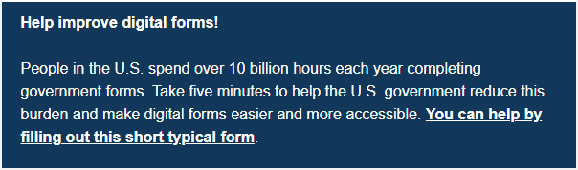
USAGov Email Outreach
Call to help improve digital forms added to bottom banner of 16 USAGov emails sent in July and August 2022
Notes:
Need to fix this slide

Slide 26
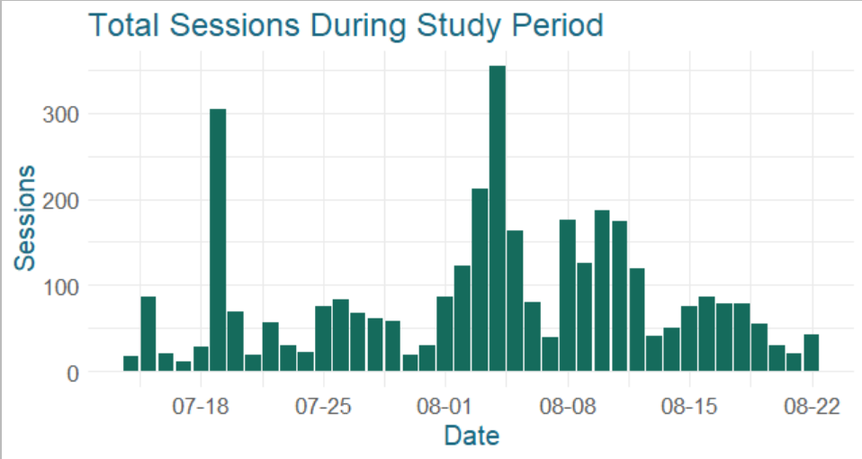
Outreach Performance 1
Who did we reach?
621,786 impressions
5,423 clicks
3,462 sessions
Outreach Funnel
0.9% of impressions yielded clicks
0.5% of impressions yielded survey sessions

Slide 27
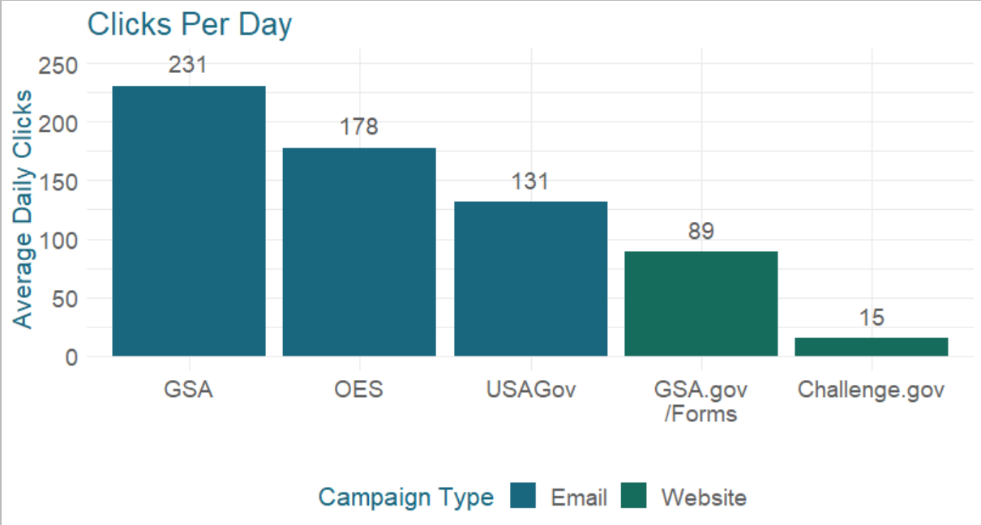
Outreach Performance 2
Outreach by Source
Average daily clicks ranges from 15 - 231.
Each day of displaying a website banner yielded fewer clicks than each email campaign we sent.

Slide 28
What did we learn?
What did we learn from the evaluation?
Where instructions are placed impacts form submission.
What did we learn about outreach?
First of its kind in the federal government that brought together multiple GSA offices and the American public.
The American public is interested in improving federal forms.
Low-cost, general outreach through federal websites, ongoing email campaigns, and social media generates an adequate sample of users.
Outreach campaigns may need to last several weeks to generate a meaningful sample.

Slide 29
Evaluation of a Form Change in the Field
29
Notes:
Stephanie section

Slide 30
Reducing Self-Reporting Errors by IFF Form Users
What was the challenge?
Federal vendors making sales through the Federal Supply Schedules are required to pay a fee—the industrial funding fee (IFF)—that covers program operations costs. IFF payments owed are a fraction of the total sales made. To accurately determine how much vendors sold, and thus the correct IFF amount, the government uses a website where vendors are asked to self-report the quantity of total sales.
What was the program change?
At no material cost, OES designed an electronic signature box included at the beginning of GSA’s online reporting portal to promote vigilant and accurate self-reporting of sales and reduce errors.
How did the evaluation work?
Vendors were randomly assigned to use one of two options: 1) the existing reporting system (control); or 2) a modified interface (treatment) with the redesigned electronic signature box.
Notes:
Vendors who sell goods or services to the government need to pay a fee, the Industrial Funding Fee, that covers program operation costs (0.75 percent of quarterly sales).
To accurately determine how much vendors sold, and thus the correct IFF amount, the government uses a website where vendors are asked to self-report the quantity of total sales.
Like for many government programs that rely on the people’s self-reports, the government cannot directly verify the accuracy of these sales reports. → Reporting errors can cost the government substantial dollar amounts.
To reduce improper sales reporting by vendors, we used behavioral insights as a strategy to curb improper sales reports.

Slide 31
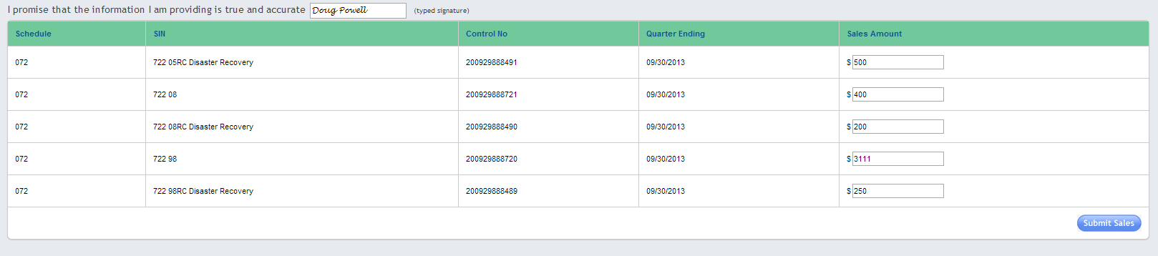
Introducing a Confirmation Prompt at the Beginning of a Self-Report Form 1
Existing electronic reporting system

Slide 32
Introducing a Confirmation Prompt at the Beginning of a Self-Report Form 2
Program change introduced a confirmation prompt at the beginning of the form:

Slide 33
Introducing a Confirmation Prompt at the Beginning of a Self-Report Form
Program change introduced a confirmation prompt at the beginning of the form:
Does the confirmation prompt reduce reporting errors (versus no prompt)?
N = 9,239 vendors see no prompt
Same business-as-usual group, no prompt
N = 18,477 vendors (2014, quarter 3)
N = 9,238 vendors
see new prompt
Prompt remains in place for intervention vendors

Slide 34
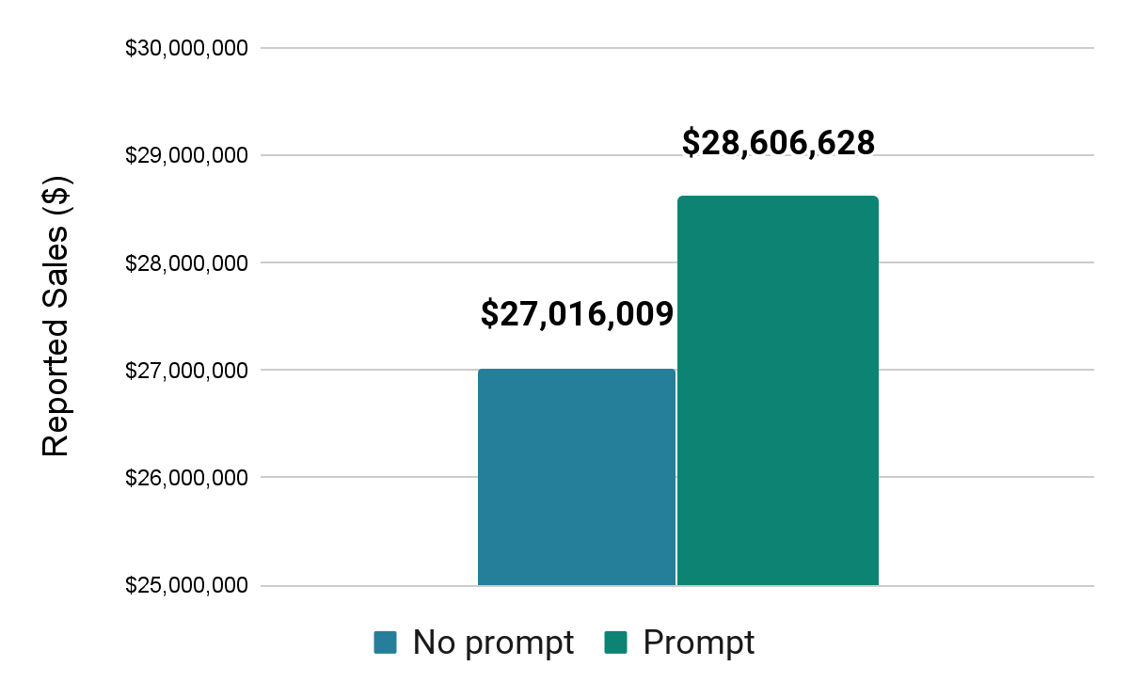
Redesigning the Reporting Form Increases Accurate Self-Reports
What was the impact?
As a result of the evaluation, the median self-reported sales amount was $445 higher for vendors signing at the top of the form, translating into an extra $1.59 million in IFF paid to the government in a single quarter.
In subsequent quarters, self-reported sales were still higher for treatment group vendors than for those in the control group, but the difference in these quarters was not statistically significant.
Reported Sales Amount in First Quarter
Notes:
After redesigning the data entry form, we tested its effectiveness.
About 18,500 vendors were randomly assigned to one of two different online forms:
The status-quo of the reporting system with no signature box; this is what we call the “control group” OR
The modified interface with the electronic signature box *before* sales are reported. The treatment group.
We find that the median self-reported sales amount was $445 higher for vendors signing at the top of the form (in the first quarter after the change was implemented).
This translates into an extra $1.59 million in IFF paid to the government in a single quarter. However, in subsequent quarters the difference between the groups was no longer statistically significant.
28606628

Slide 35
Takeaways and Next Steps
35
Notes:
Blair section

Slide 36
Connections to other government priorities
21st Century Integrated Digital Experience Act
The Act aims to improve the digital experience for government customers.
Foundations for Evidence-Based Policy Making Act of 2018
Supports evaluation and other evidence- building activities across the federal government
Presidential Management Agenda Learning Agenda
Deliver excellent, equitable, and secure federal services and customer experience
Executive Order on Transforming Federal Customer Experience and Service Delivery to Rebuild Trust in Government
Evaluate improvements to “design and deliver services that people of all abilities can navigate.”
Memorandum on Restoring Trust in Government through Scientific Integrity and Evidence-Based Policymaking
Support “evidence-based decisions guided by the best available science and data.”

Slide 37
Evaluation on High-Burden Federal Forms
Identify High-Burden Forms
Work with agencies to identify federal forms that pose high burdens for citizens.
A/B Test Forms Improvements
Design A/B tests to evaluate the effectiveness of improvements to burdensome forms.

Slide 38
For further information on working with us to improve federal programs and policies: oes@gsa.gov
oes.gsa.gov
@OESatGSA and #OESatGSA
38

